Slide 1
Investor Relation
Eco-Friendly System&Engineering Solution
2023

Slide 2
01
CEO’s greeting
Founded in October 1991 , Eco-Friendly System Engineering Solution Company provides propulsion systems and engineering solutions for eco-friendly ships since 2021 based on years of technology in industrial automation and electrical control.
As the Eco-Friendly Ship Act is newly enacted in 2020, we are consistently making efforts to commercialize domestic eco-friendly ships, and we will make efforts to promote our technology to the global market and lead the eco-friendly ship market.
As a ready partner right next to you
Improve service and maximize each other's expertise
I will always try to contribute to value creation.
As a partner who will open the future of
our customers together
We focus on developing customized services with
customer satisfaction as the top priority, To deliver customer-
centric continuous service and optimal solutions.
I will always do my best.

Slide 3
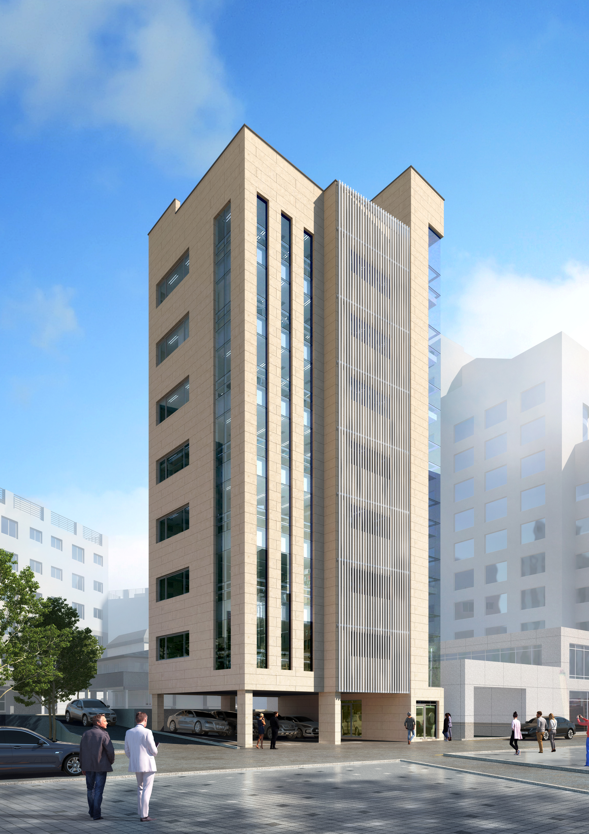
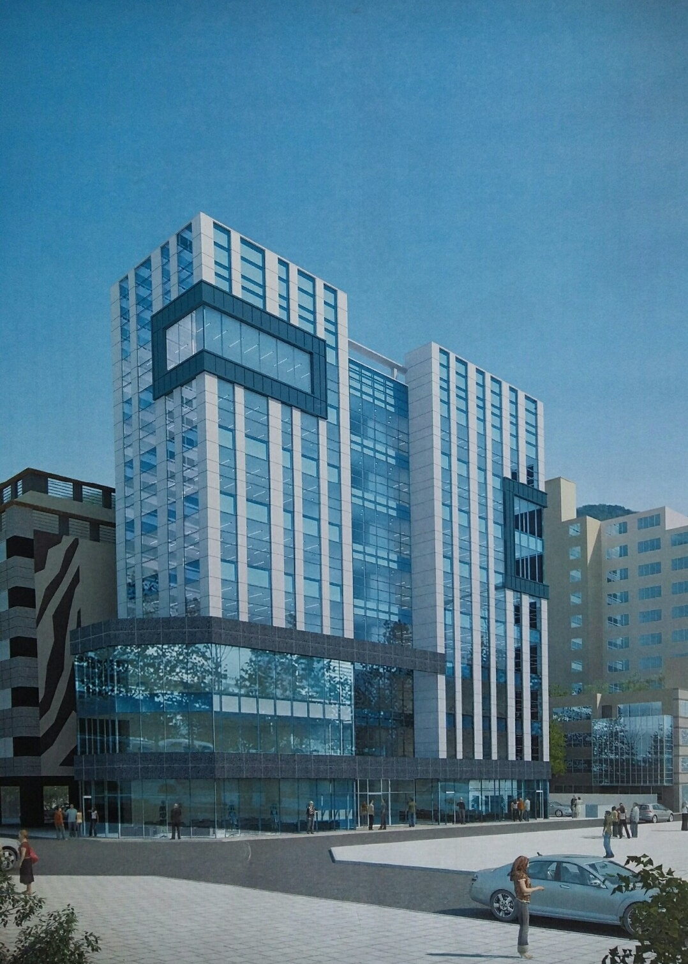
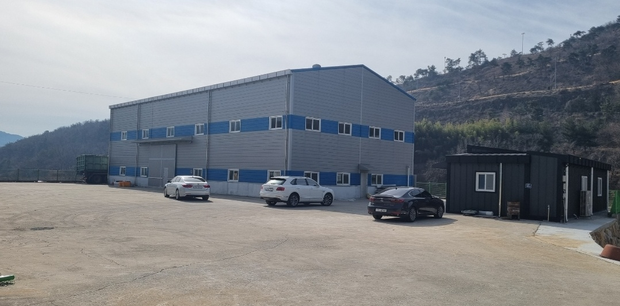
02
Company Introduciton
Research & Development center
Head Office
Compnay DONG-IN ENSIS Co., Ltd.
C.E.O NAMSOON BAEK
Date of
Establishment October 1991
Location Yangjeong-dong, Busan
Qualtiy
Cetification ISO 9001:2005
Environmental
Certification ISO 14001:2005
Date of
Establishment September 2020
Certification
number No. 2020114949
Location Yangjeong-dong,Busan
A fIeld of Study Eco-friendly ships
Equipment and
technology
development
Factory
Date of
Establishment February 2008
Location Gijang-gun,Busan

Slide 4
Industrial Automation
03
Engineering Solutions
Based on various experiences and technical know-how
Deliver optimal solution engineering services
Condition Monitoring
with continuous monitoring of the facilities
Enable rapid and accurate process control,
facility diagnosis and maintenance
Partner of DONG-IN ENSIS Co.,Ltd
Data Acquisition & Analysis
Sensor, PLC, HMI, instruments, and other instruments (equipment)
Collect various analog and digital data that are measured and output
Analyze collected data – improve quality, diagnose facilities and establish preventive maintenance plans
Process Control
- Operate facilities efficiently and maximize productivity
- Increase competitiveness by reducing production costs
- Improve quality and reduce costs due to reduced defect rate
- Improve production and inspection process capabilities
SCADA
(Supervisory Control And Data Acquisition)
- Remote control of industrial processes
- Real-time data-driven process monitoring
- Real-time data collection for follow-up and assessment
In the face of growing interest in 4th industrial technology, the SCADA system is designed to enable
an important role in the operation of the industry

Slide 5
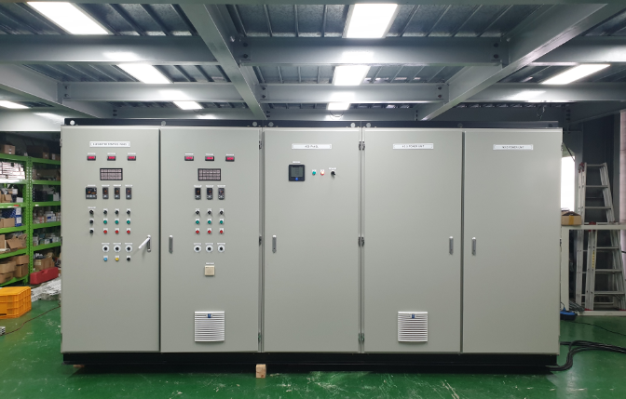
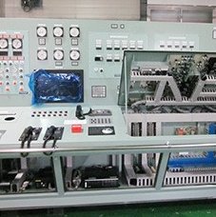
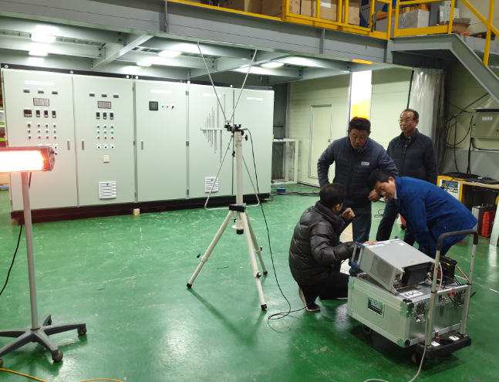
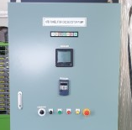
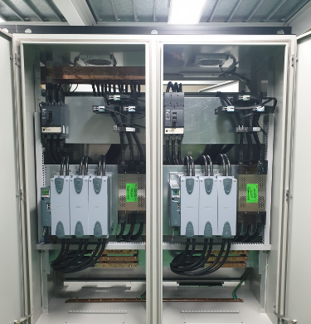
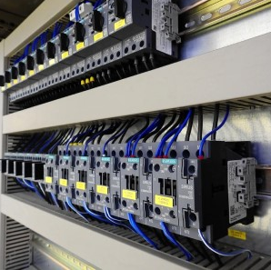
Electrical Control
04
Engineering Solutions
-Pump Control
-Drawing Machinery Control
-Heater Control
-Blower / Fan Control
-Textile Machinery Control
-Crane Control
-HVAC System Control
-Conveyor Control
-Mixer Control
Based on various experiences and technical know-how
Deliver optimal solution engineering services
Partner of DONG-IN ENSIS Co.,Ltd

Slide 6
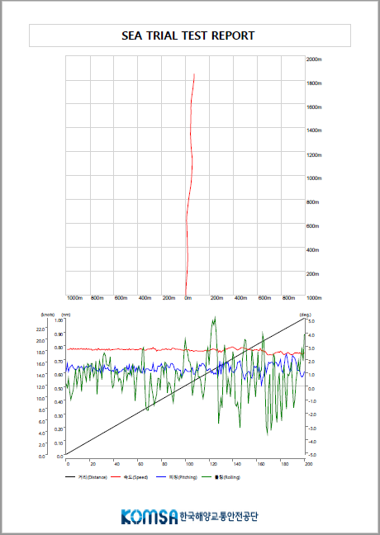
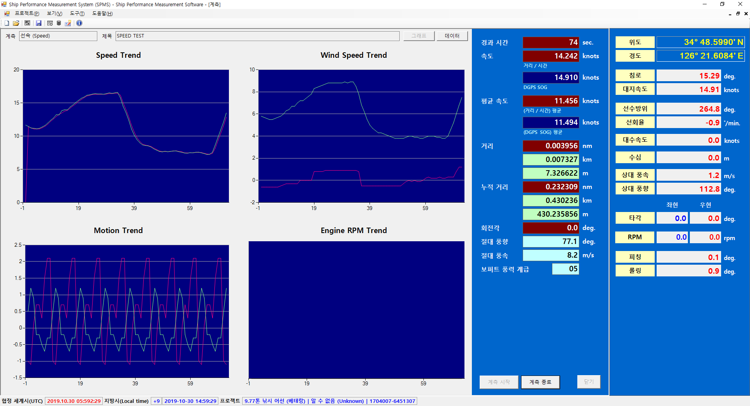
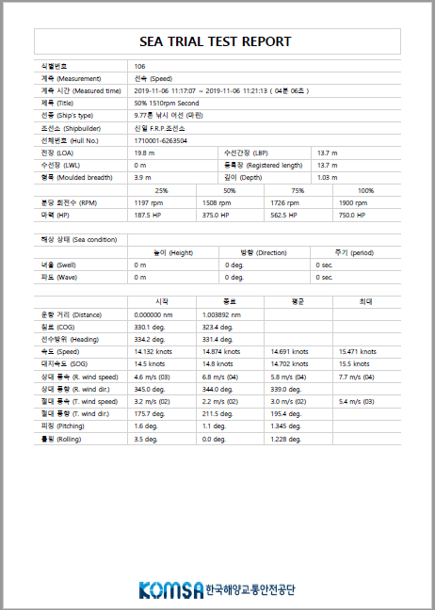
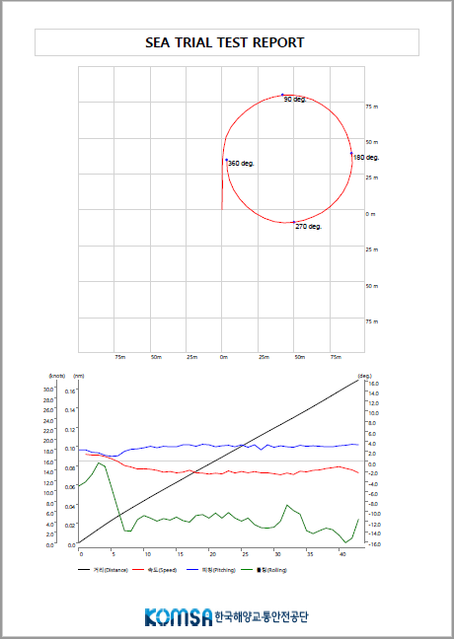
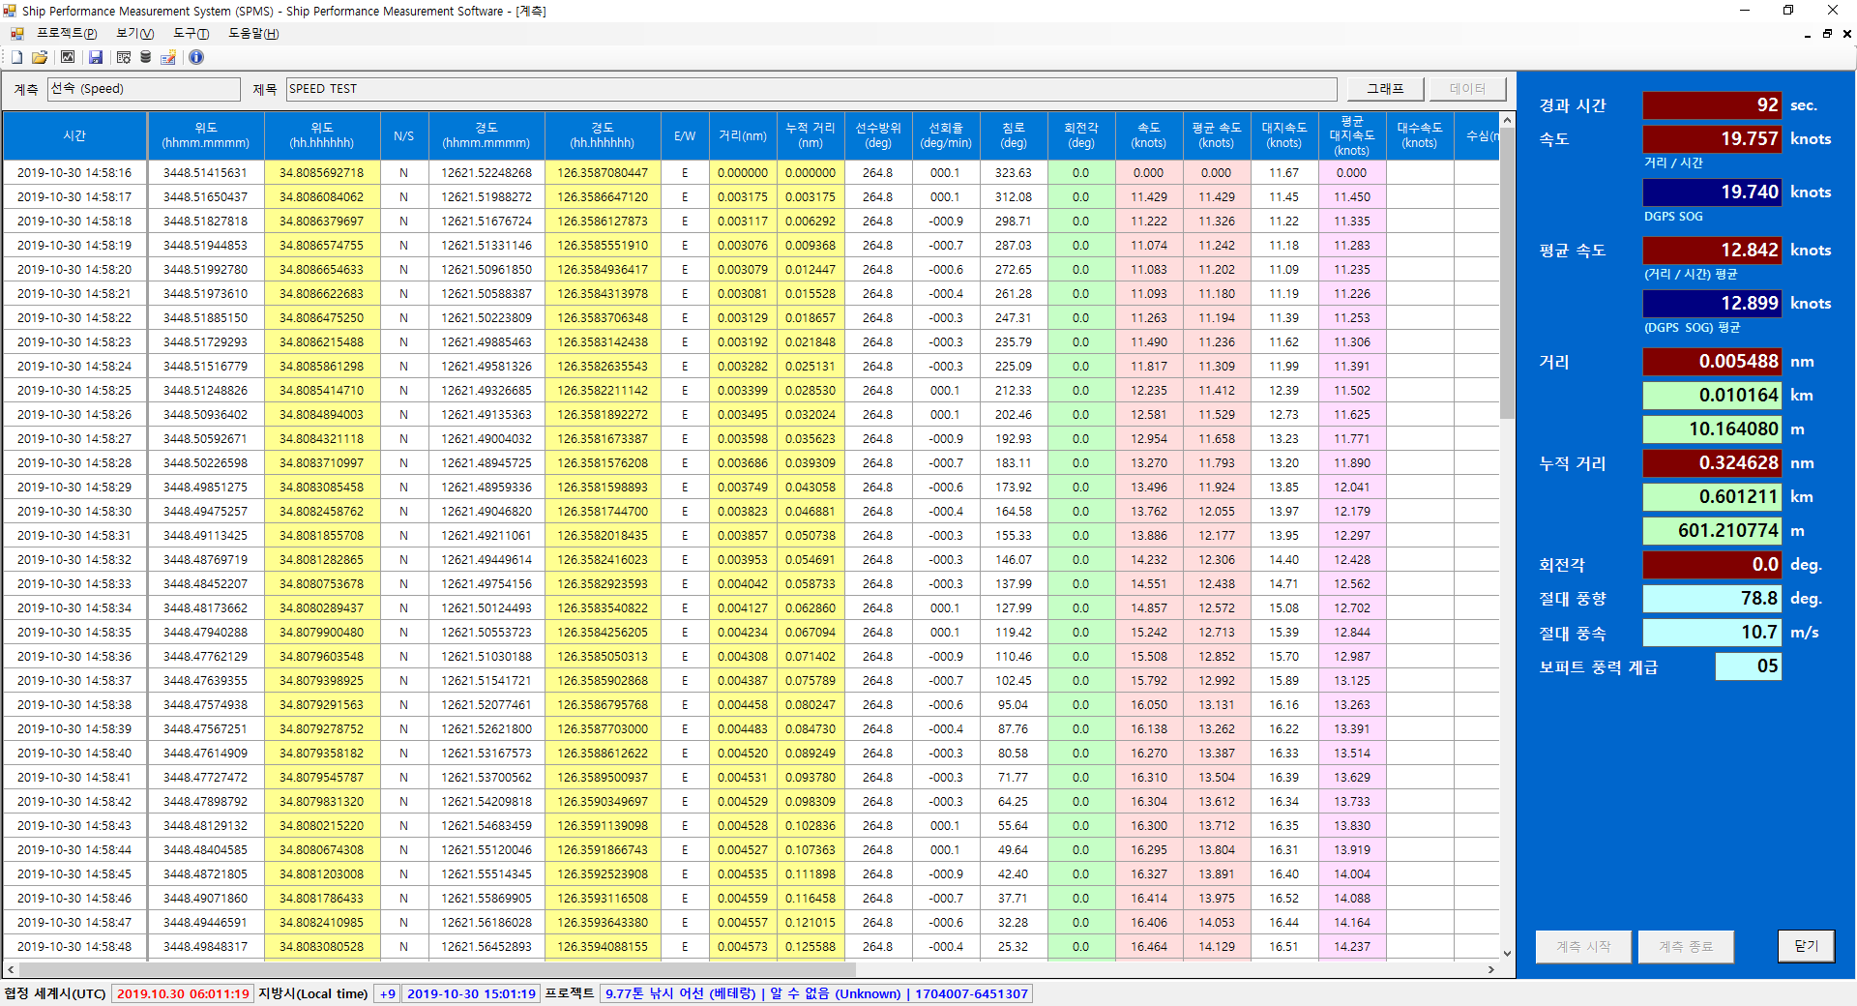
Shipbuilding/Marine Applications
05
Engineering Solutions
System Integration based on Ethernet
DGPS
GPS
Compass
Wind
Sensor
Portable
Ships maneuverability measuring system
DGPS
Gyro
Compass
Speed
Log
Ship
Engine
Wind
Sensor
Rudder

Slide 7
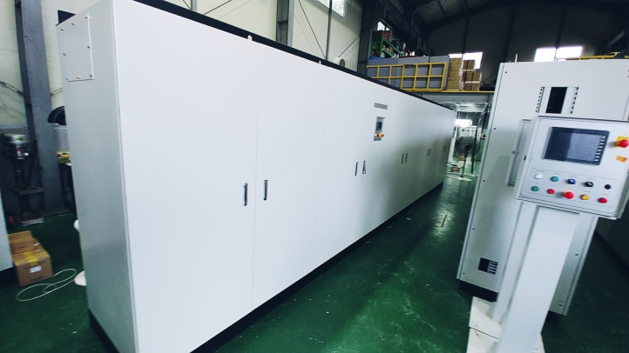
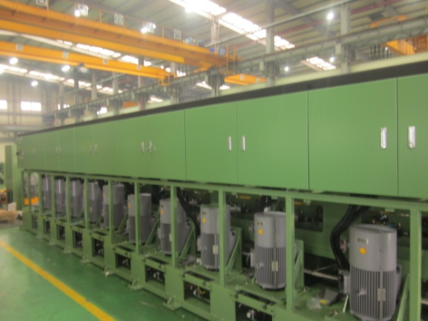
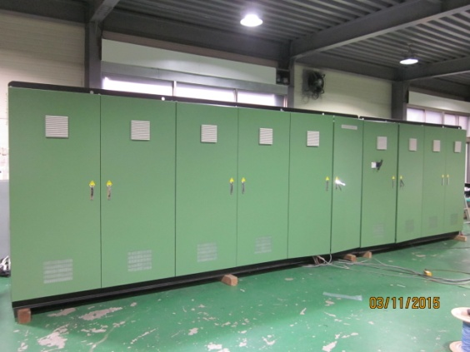
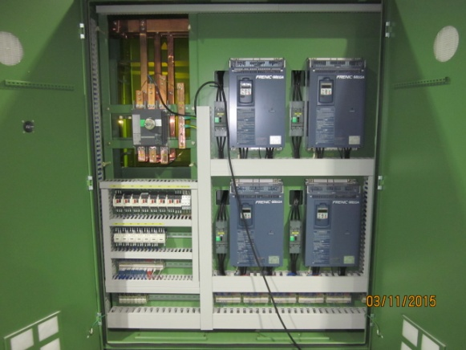
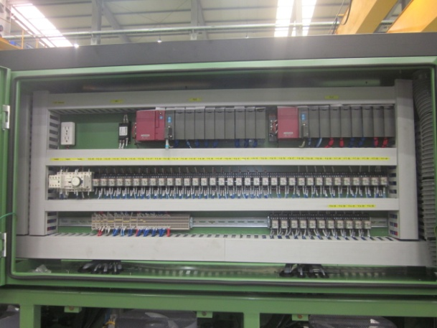
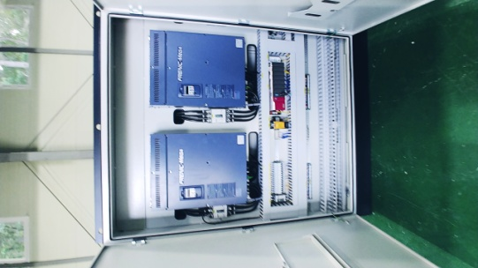
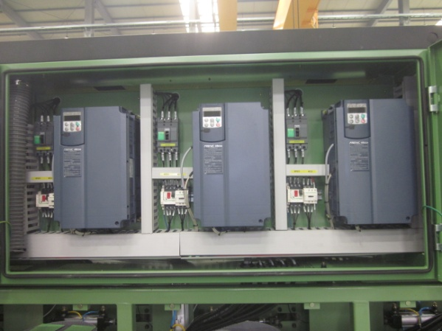
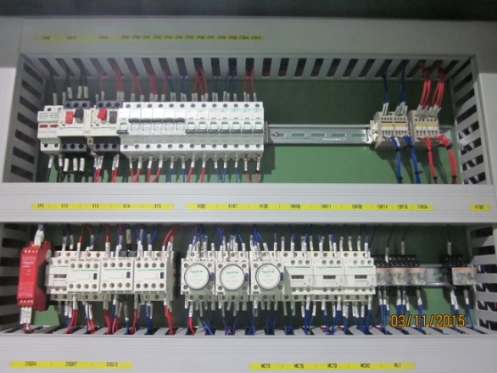
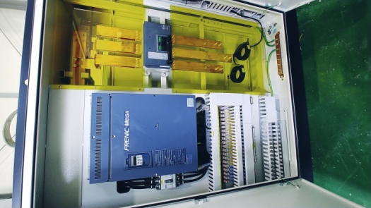
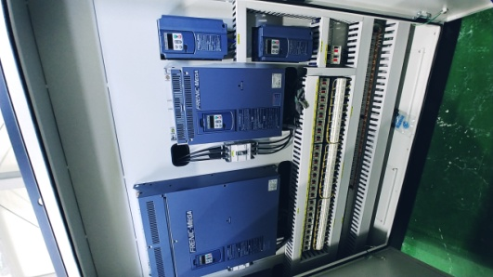
Factory Production Equipment Automation
06
Performance
KISWIRE Co., Ltd
(yangsan factory)
Koswire Co., Ltd
(Uiryeong Factory)
KOSWIRE Co., Ltd
(Czech factory)
Continuous Drawing m/c (24"X12H+SP)
INVERTER : Total 635kW
FRN75G1S-4DR(75KW, 400V) x 1 EA
FRN55G1S-4DR(55KW, 400V) x 6 EA
FRN37G1S-4DR(37KW, 400V) x 5 EA
FRN45G1S-4DR(45KW, 400V) x 1 EA
Continuous Drawing m/c (36"X8H+SP)
INVERTER : Total 917kW
FRN110G1S-4DR (132KW 400V) x 8 EA
FRN37G1S-4DR (37KW 400V) x 1 EA
Continuous Drawing m/c (16"X10H+SP)
INVERTER : Total 165kW
FRN15G1S-4DR(15KW 400V) x 11 EA

Slide 8
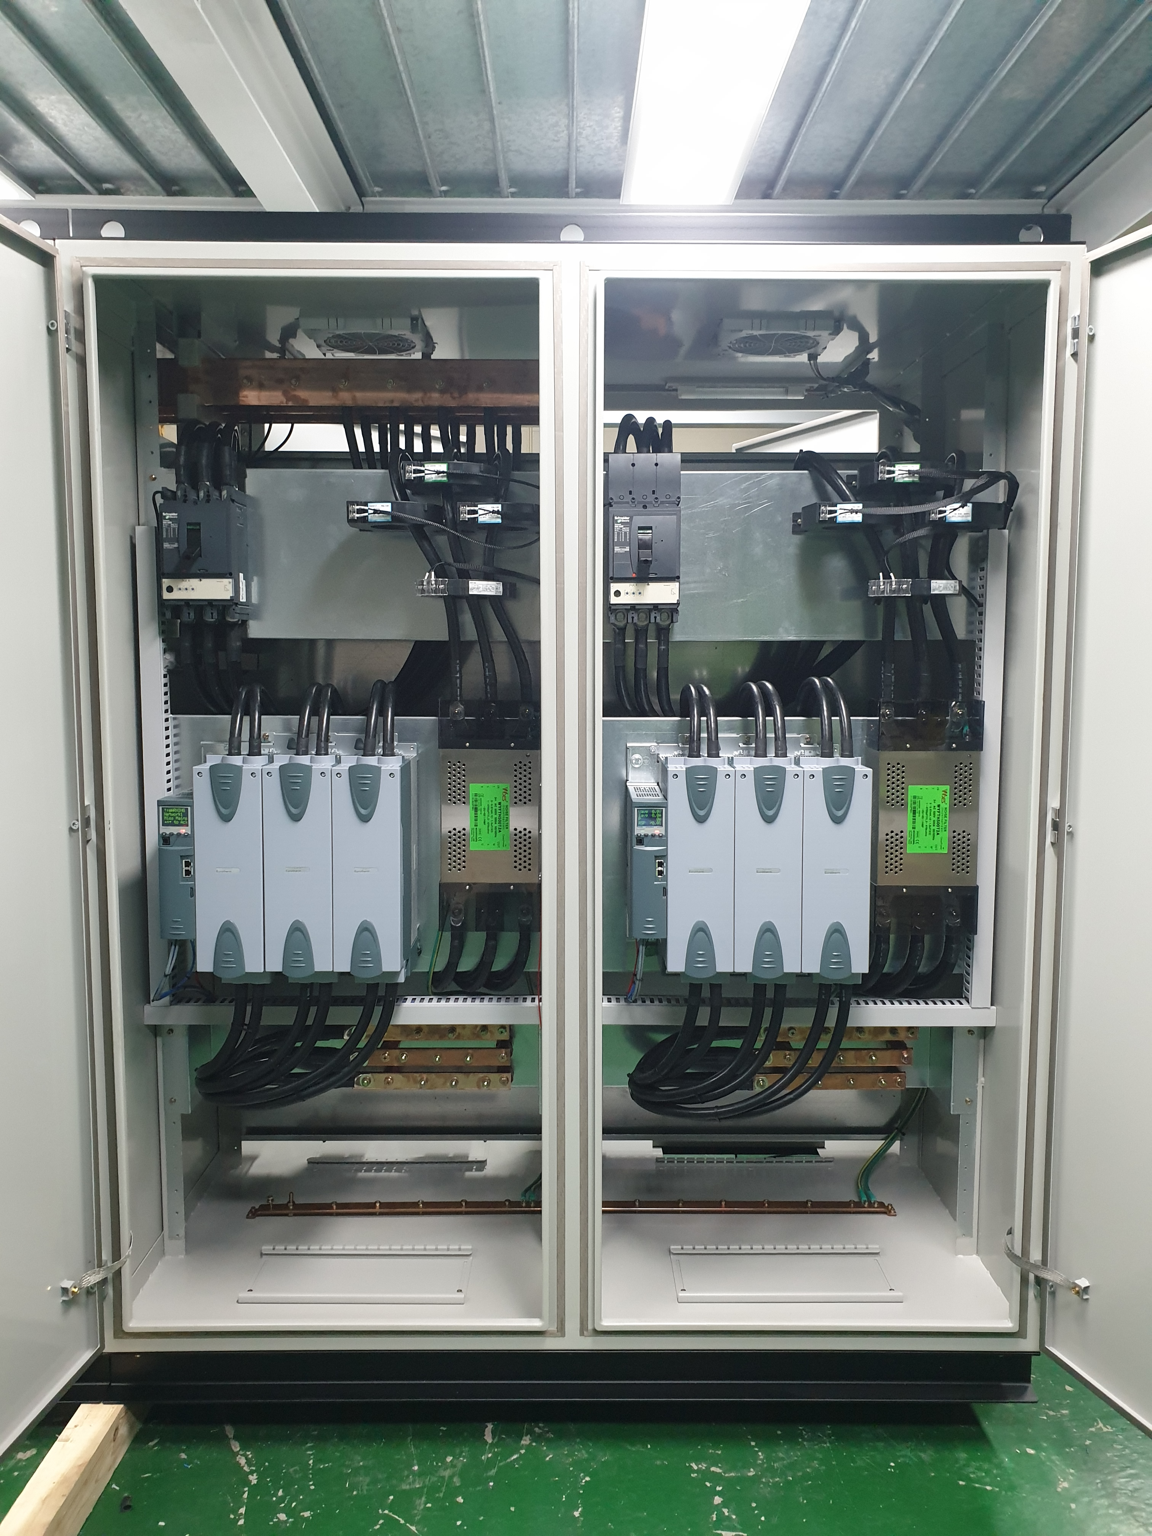
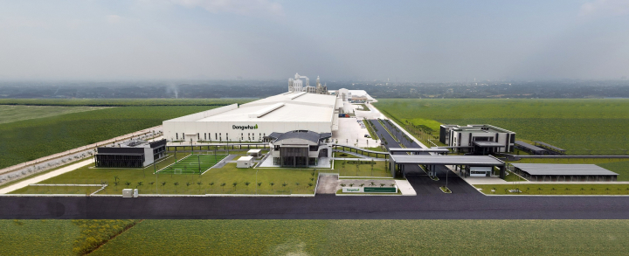
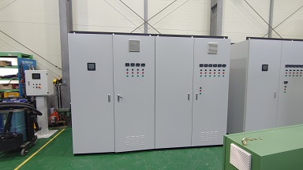
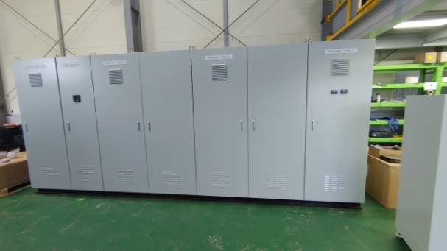
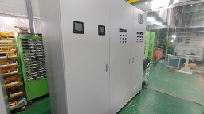
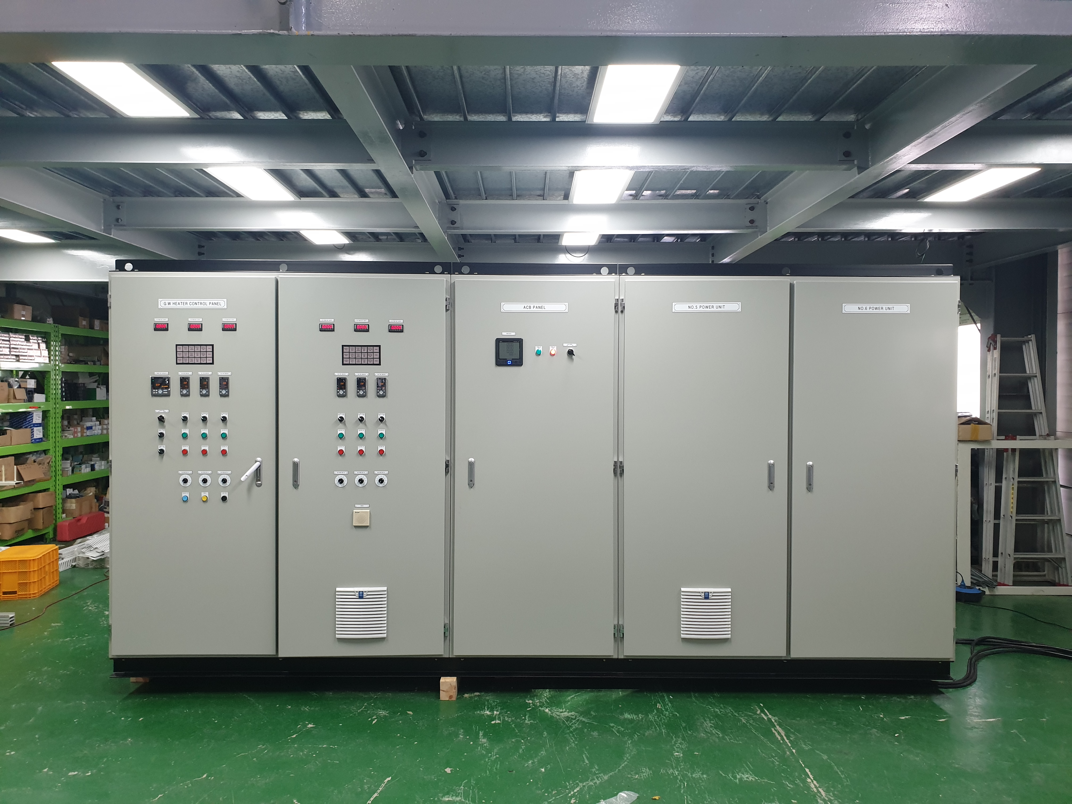
Factory Production Equipment Automation
07
Performance
Donghwa Corporation
Vietnam Factory
FORMALIN & RESIN PLANT
Electrical and instrumentation systems
design/manufacture/installation work/commissioning
MCC PANEL / PLC PANEL
design/manufacture/installation work/commissioning
LNG SYSTEM TEST FACILITY
G/W HEATER CONTROL SYSTEM

Slide 9
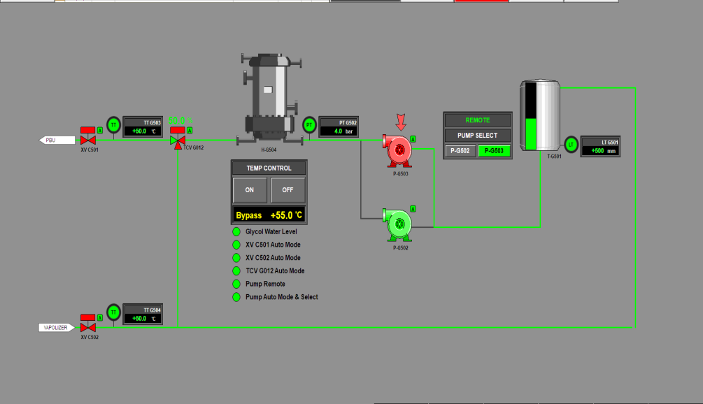
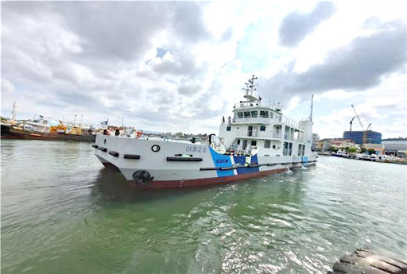
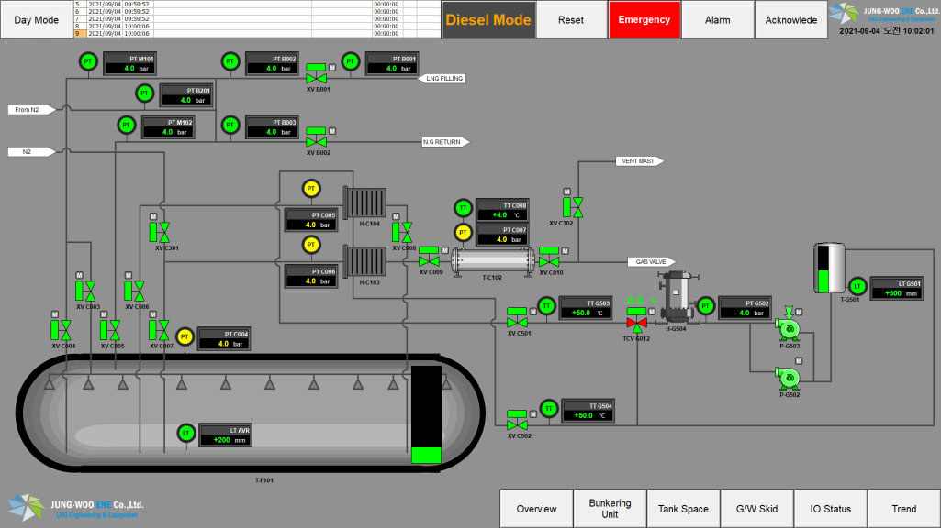
Eco-Friendly Ship
08
Performance
Ministry of Oceans and Fisheries
Yeosu Regional Maritime Affairs and Fisheries Office
280-ton Cheonghang ship
LNG Fuel Propulsion System
Fuel Gas Supply Control &
Monitoring System

Slide 10
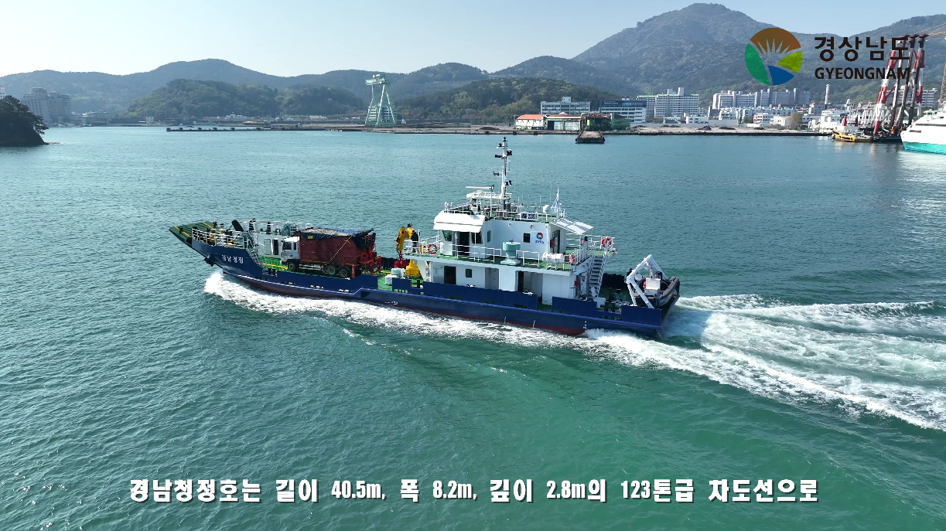
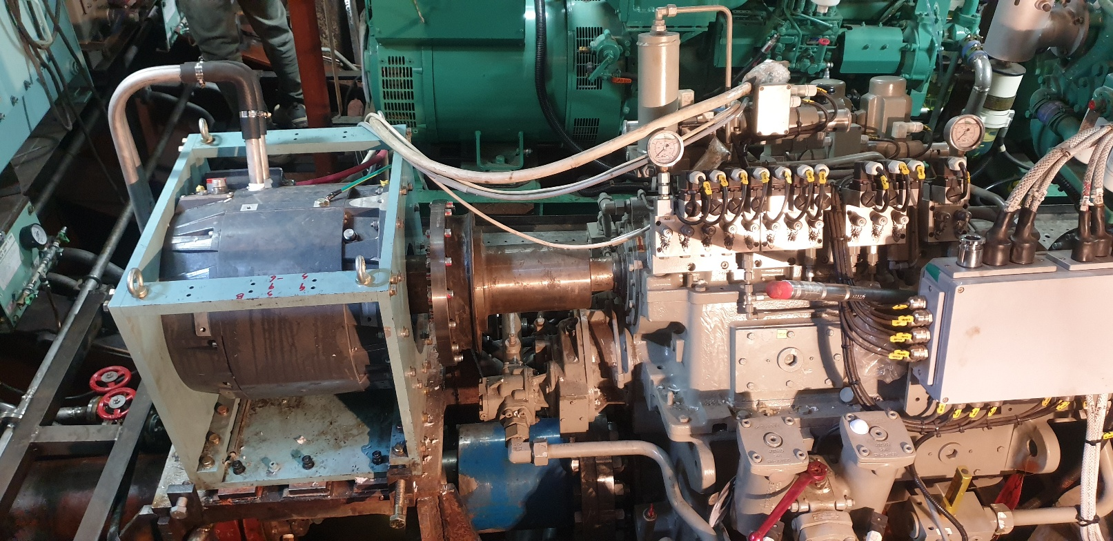
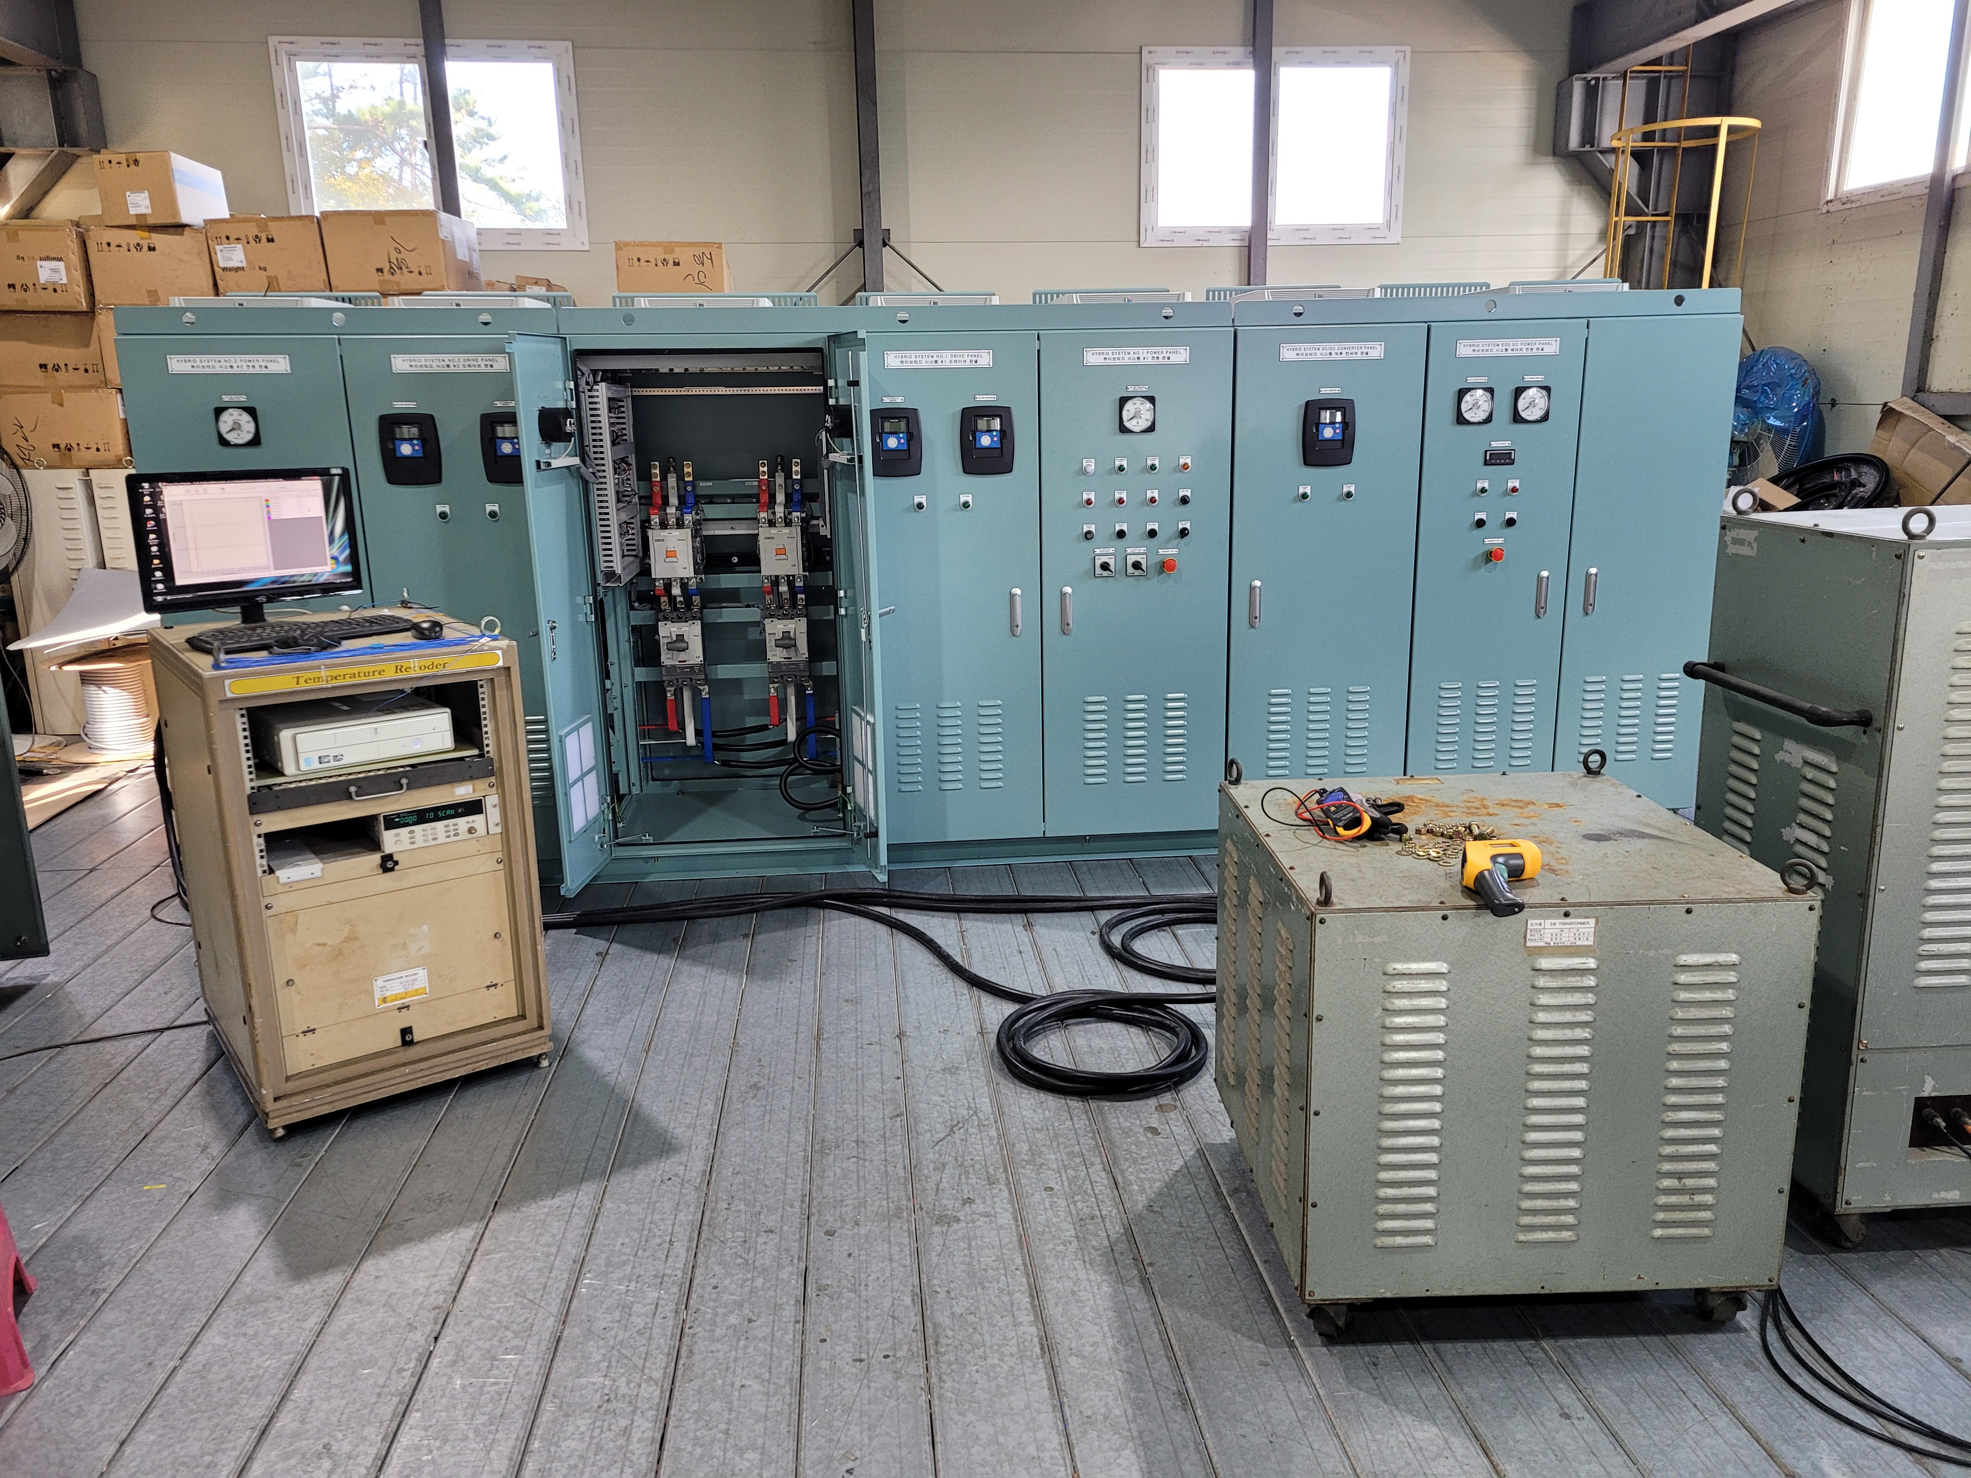
Eco-Friendly Ship
09
Performance
main components
2 x Propulsion Motor
2 x Grid Converter
2 x Generator Inverter
1 x DC/DC Converter
1 x Energy Storage System Total system energy 424.0kWh
1 x Integrated Control &
Monitoring System
propulsion motor
Type : PM
Nominal voltage : 500 VAC
Nominal current : 284 A
Nominal power : 215 kW
Nominal speed : 2800 rpm
Nominal frequency : 280 Hz
123-ton Environmental
cleaning & Waste collection Ship
Hybrid Propulsion System

Slide 11
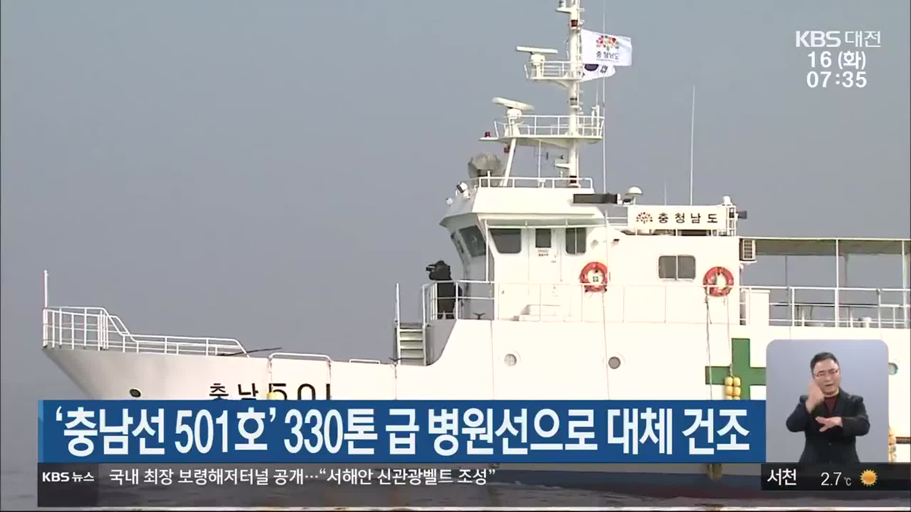
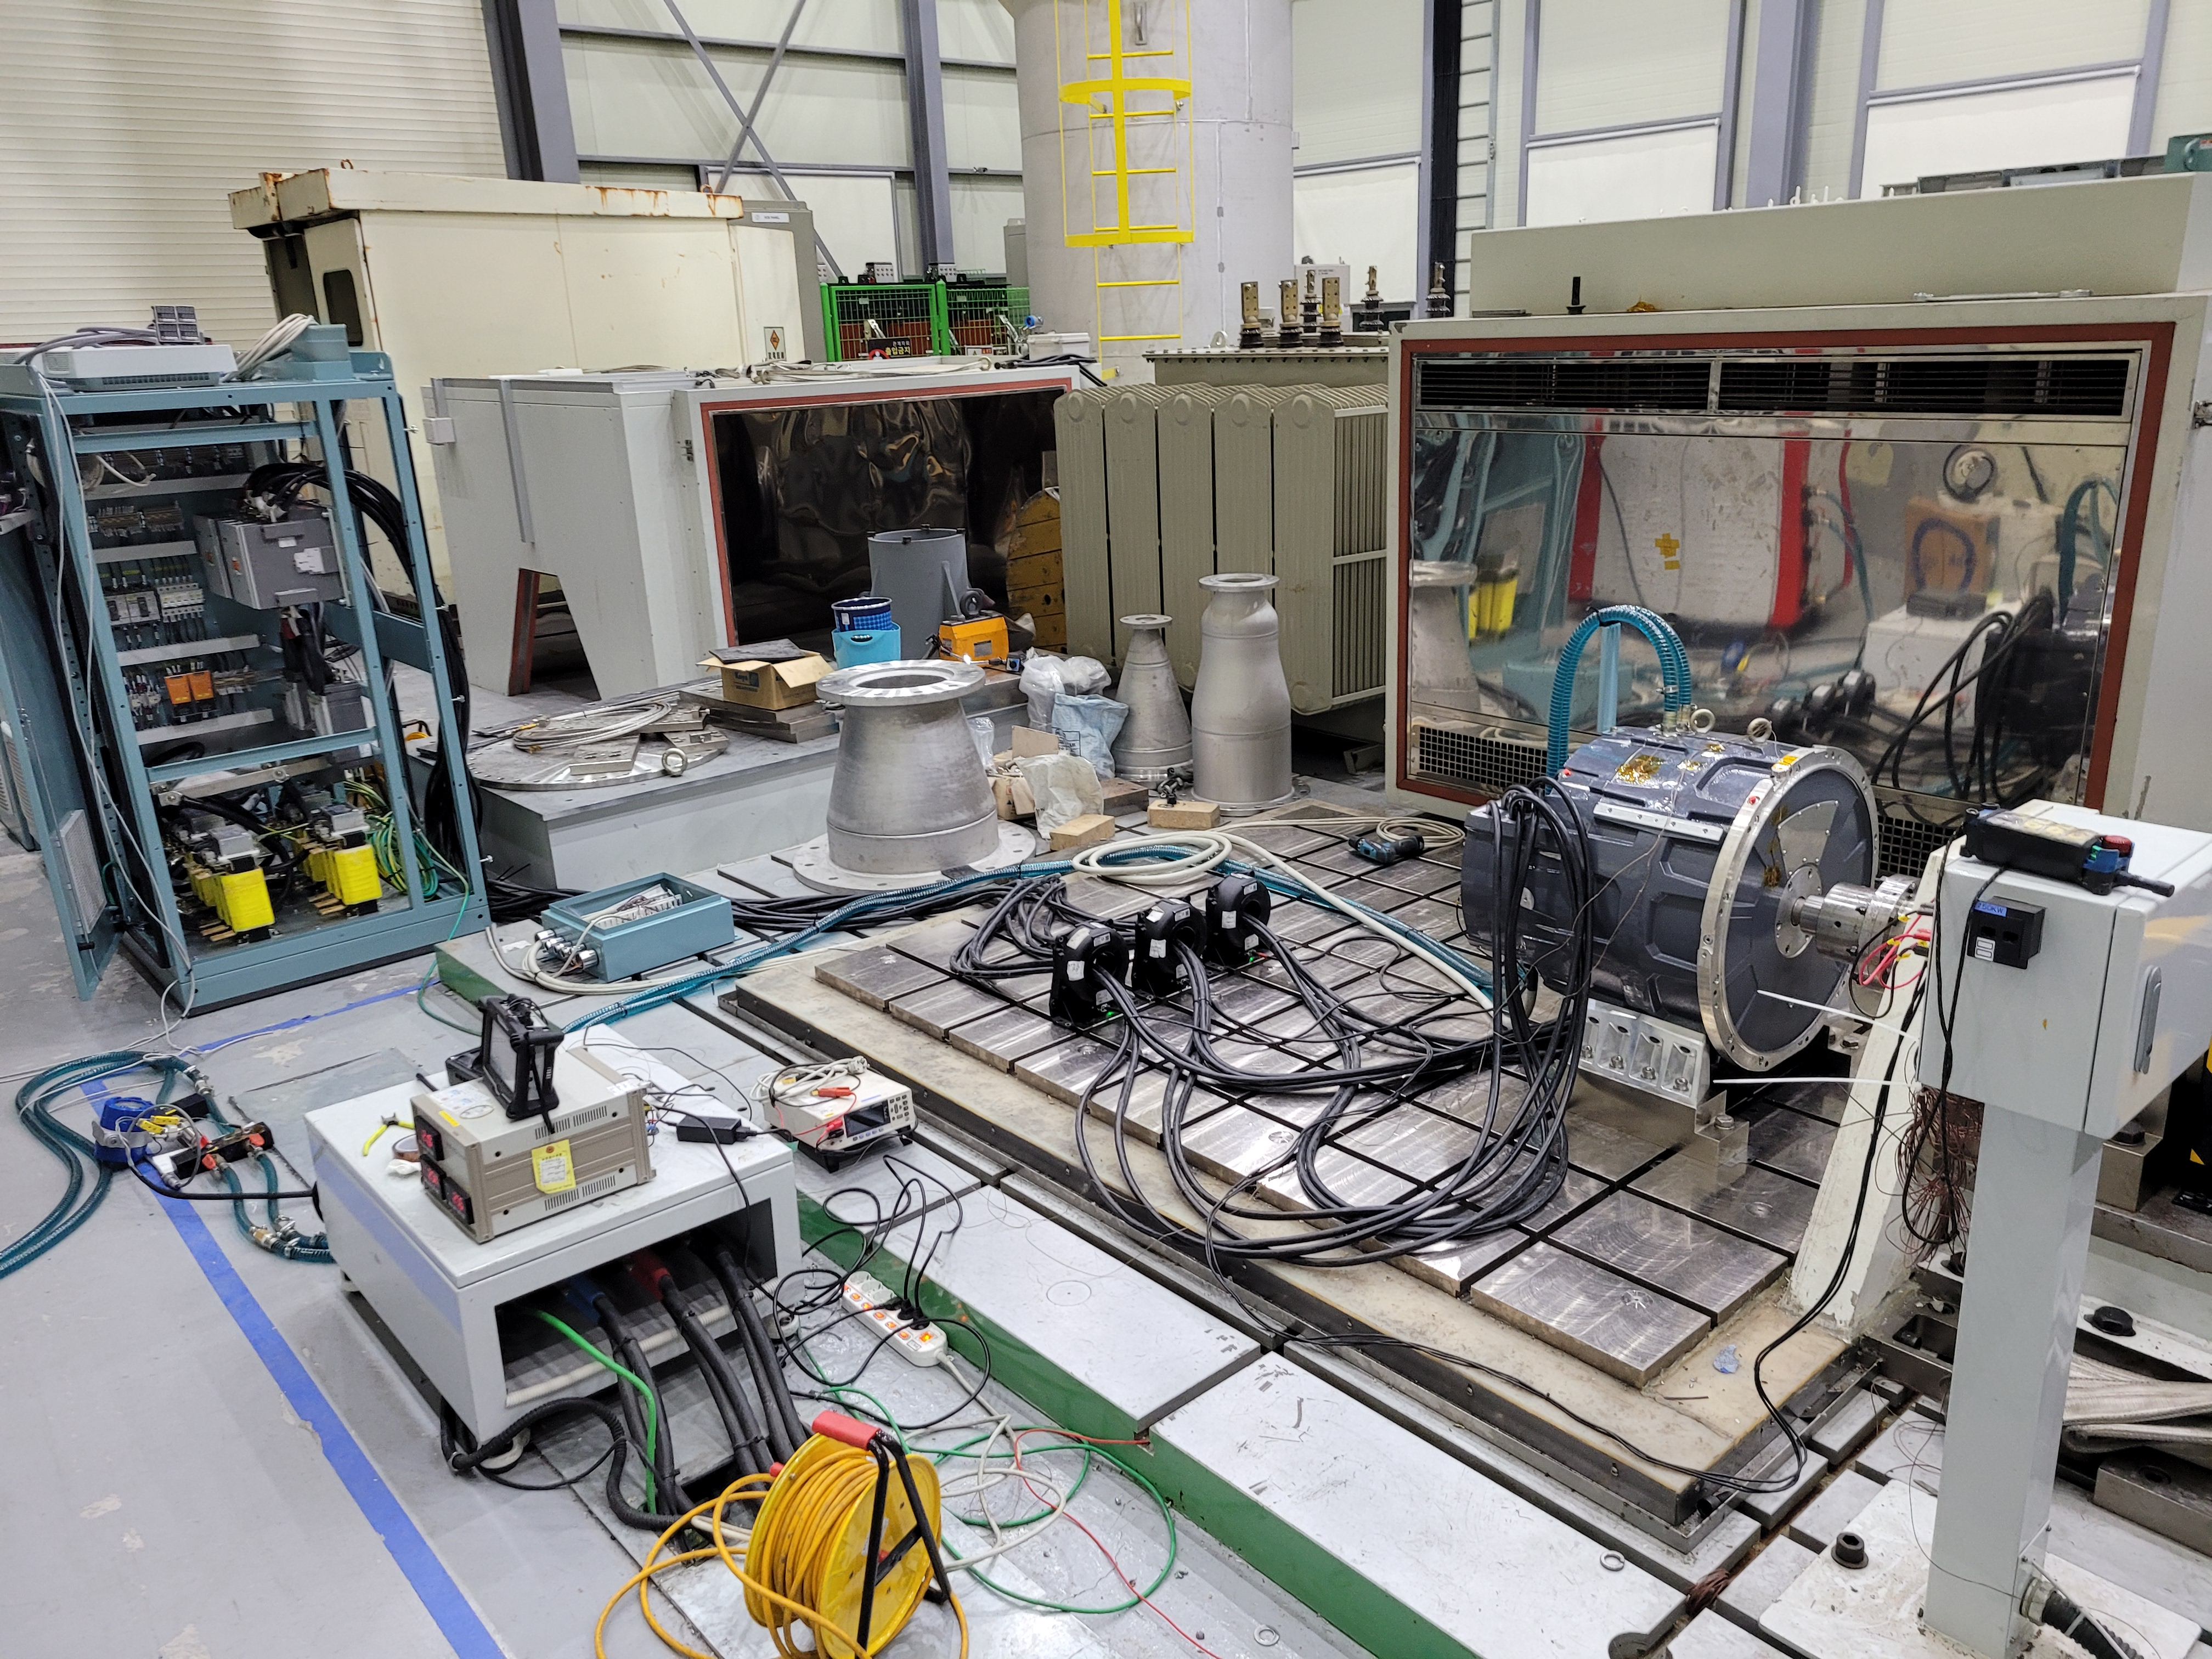
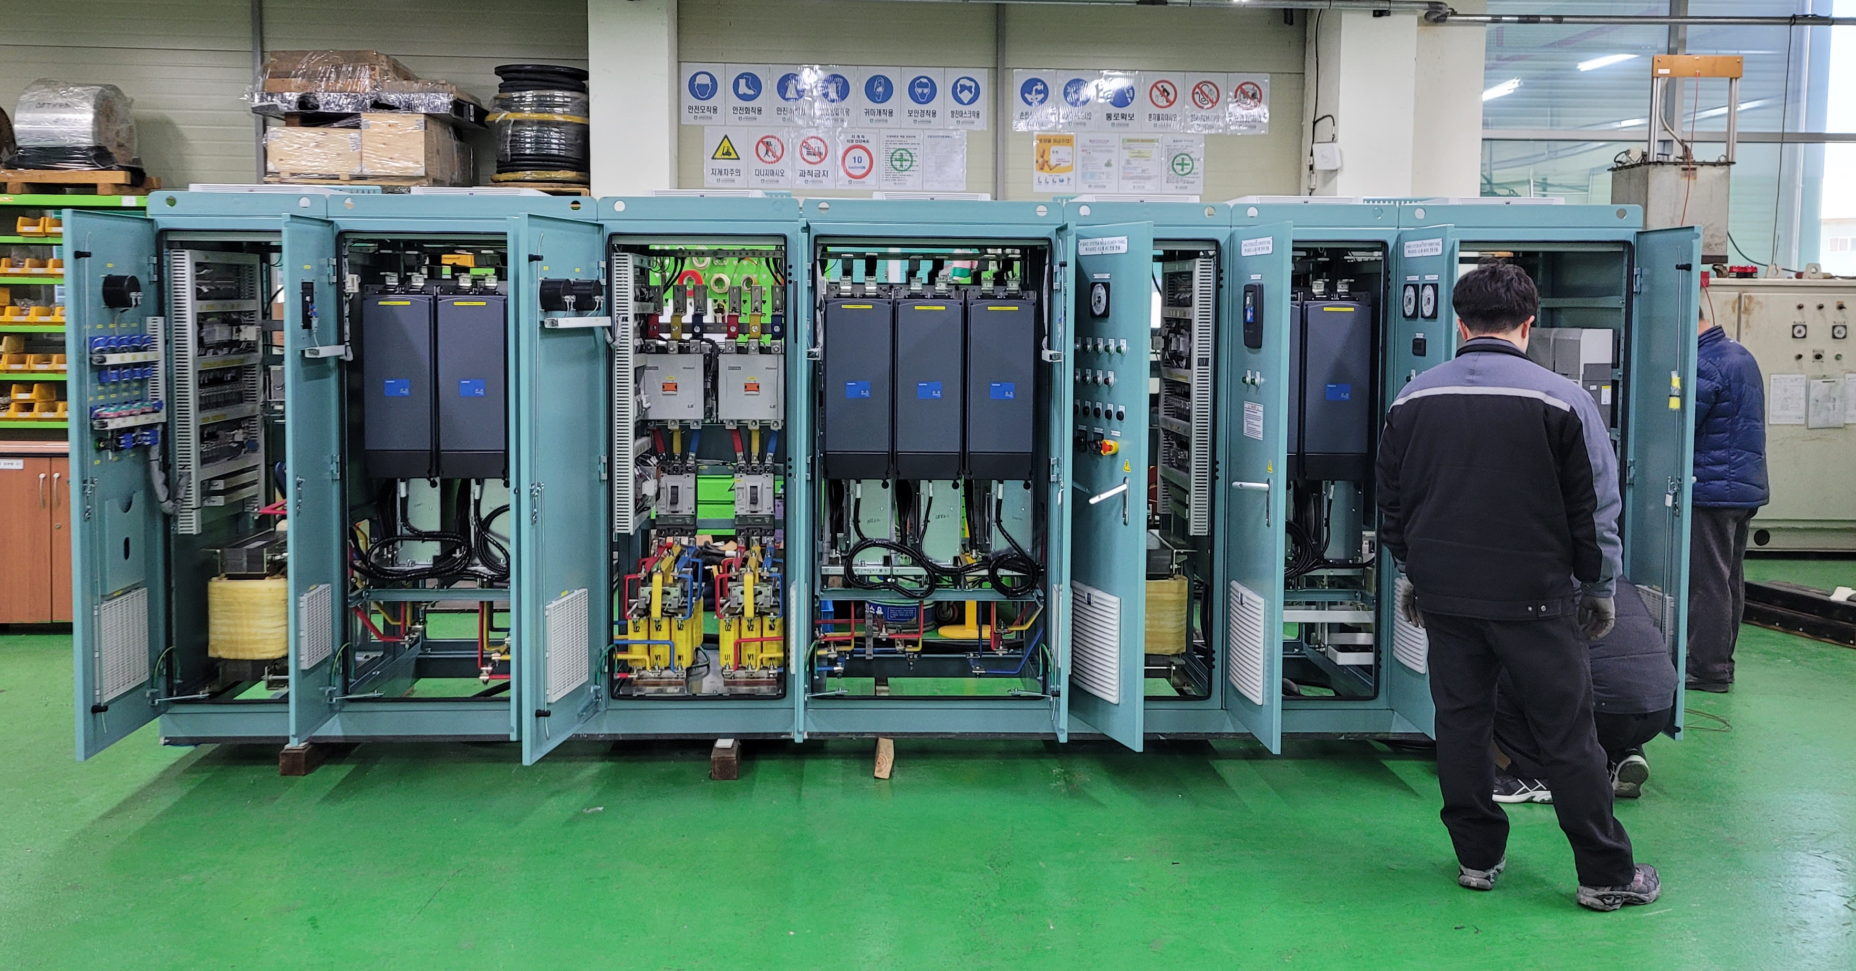
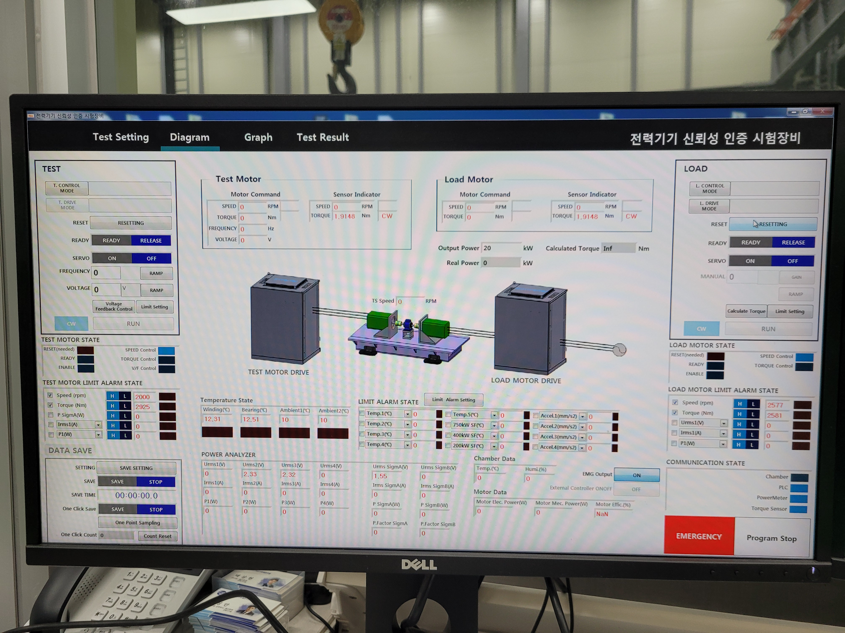
Eco-Friendly Ship
10
Performance
main components
2 x Propulsion Motor
2 x Grid Converter
2 x Generator Inverter
1 x DC/DC Converter
1 x Energy Storage System Total system energy 395.5kWh
1 x Integrated Control &
Monitoring System
propulsion motor
Type : PM
Nominal voltage : 500 VAC
Nominal current : 414 A
Nominal power : 303 kW
Nominal speed : 1800 rpm
Nominal frequency : 240 Hz
330-ton hospital ship
Hybrid Propulsion System

Slide 12
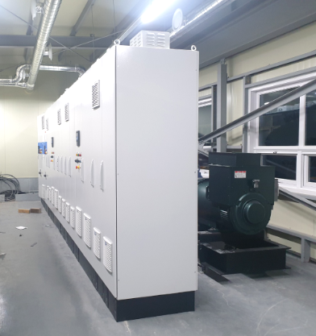
Shipbuilding & Marine Engineering Center
11
Performance
(G)Korean shipping
Shipbuilding & Marine Engineering Center
for Applied Demonstration Technology
Localization of systems development, design and engineering
For Research and Development of Eco-friendly Electric Propulsion Vessels
Co-establishment and operation
400kW VFD(Variable Frequency Driver)
Development and system fabrication
DC / DC Converter
for ESS charging & discharging
Main Switchboard
Power Management System Panel
Load Bank Control System Panel
VFD for load bank fan control
Gas Fuel Hybrid Electric Propulsion System for Coastal Ships
Development of safety and application technologies
Water Cooling System Panel
Research and Development of Related Technologies for Environmentally Friendly Ships in Korea
Hybrid electric propulsion system, PMS, PCS,
Battery performance test

Slide 13
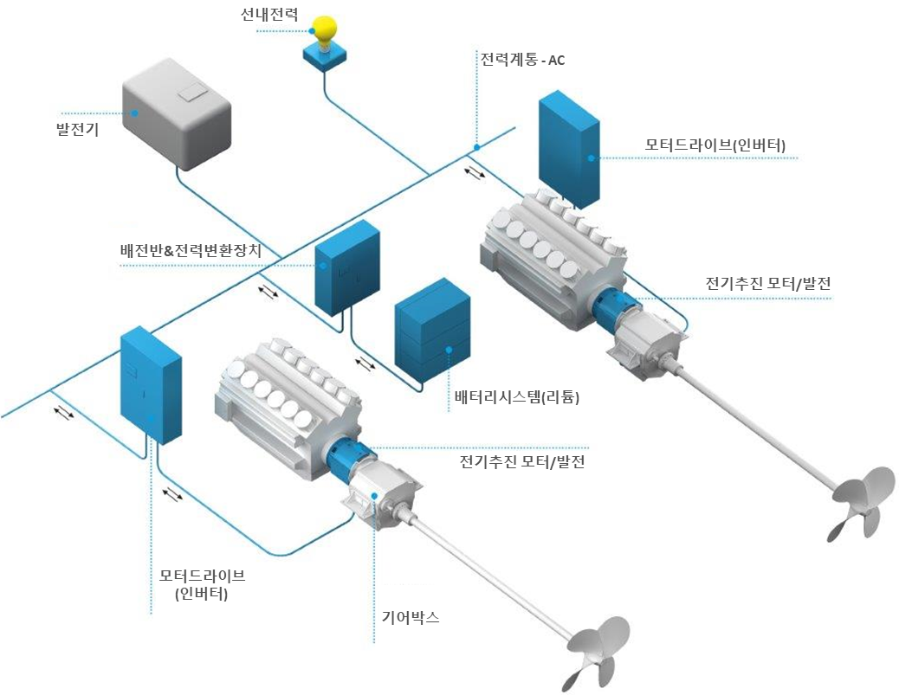
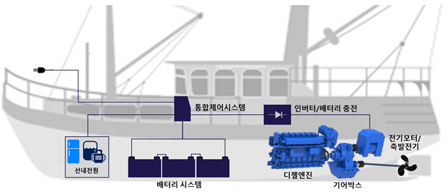
12
Eco-Friendly R&D
Development of Core Equipment Technology for Electric Combined Propulsion Fishing Vessels
Supervision of institution
Participating of institution
Korean Register of shipping
Performance of DONG-IN ENSIS Co., Ltd
Development of integrated electric propulsion control system prototype, LTE-based land control monitoring prototype, construction and testing of land battery ship charging system

Slide 14
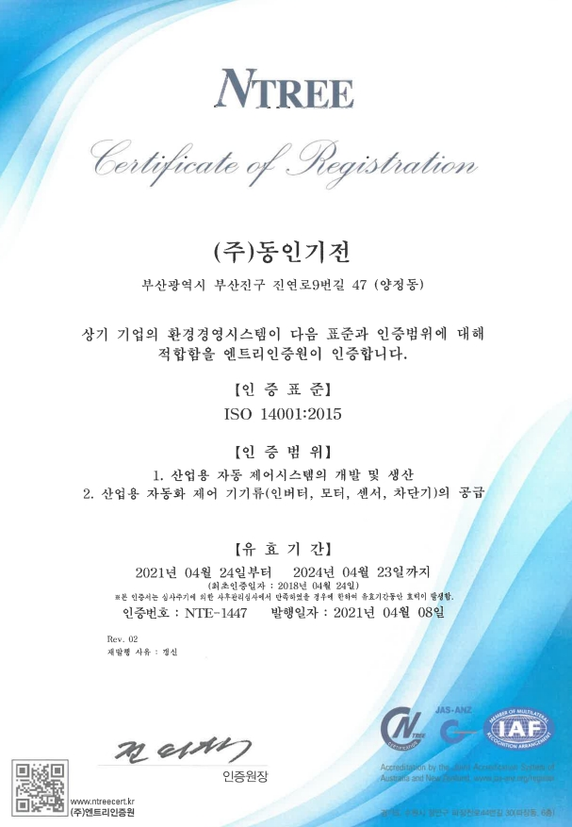
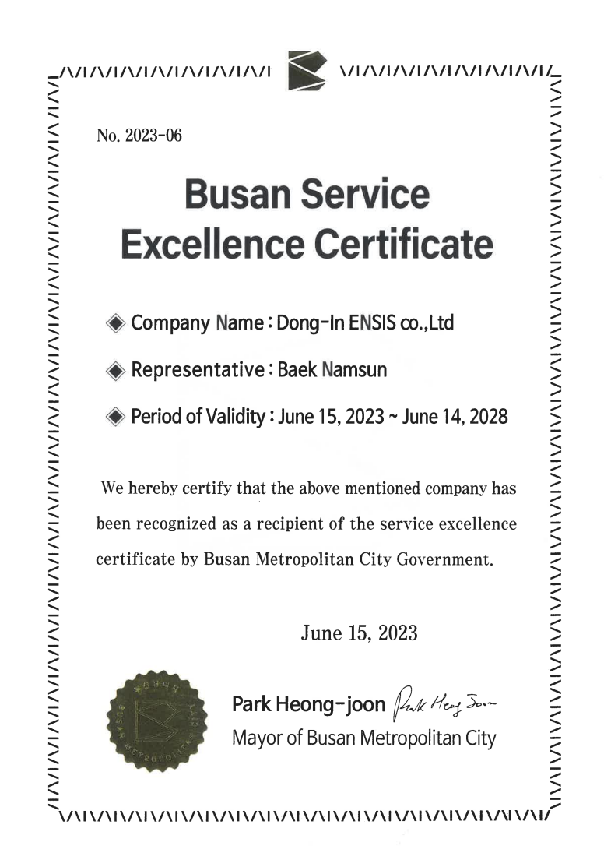
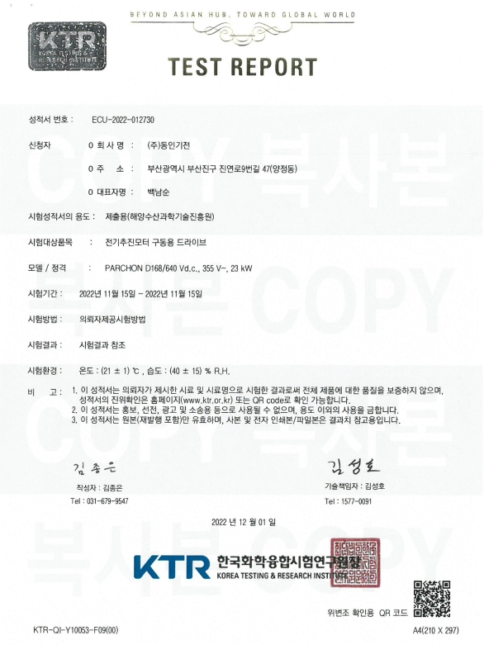
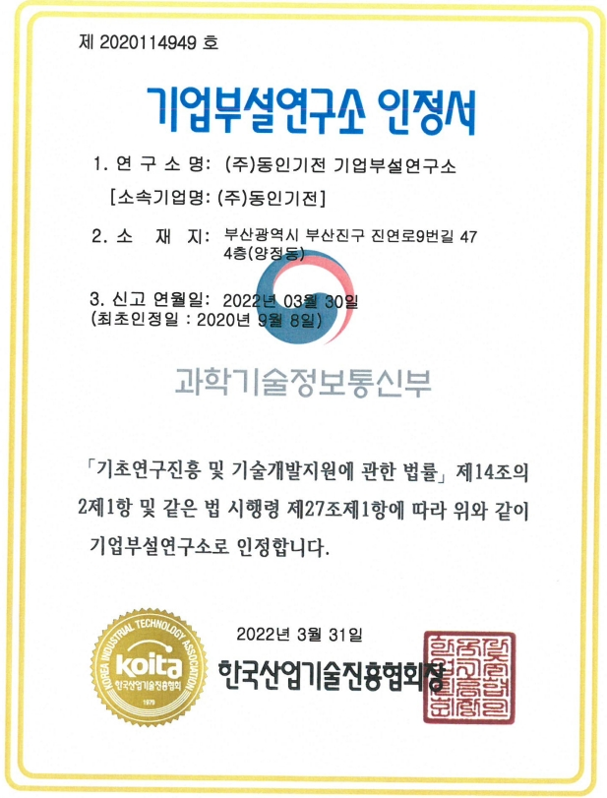
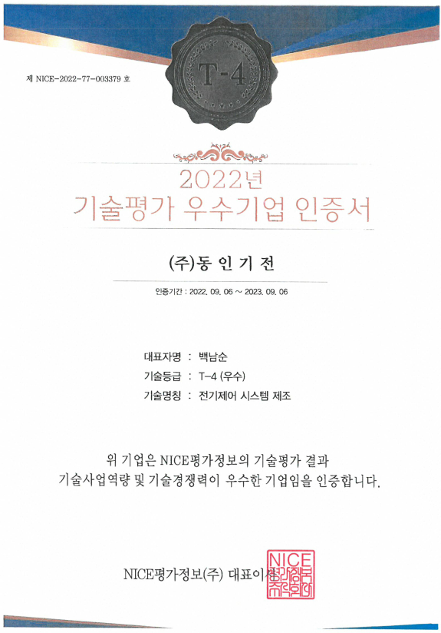
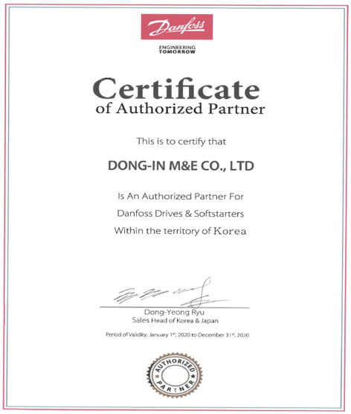
13
Certification
ISO9001
ISO14001
National Representative Innovation Company
Excellence Certificate
Authorized test report
Research Institute
Excellent Technological Evaluation Certification
Certificate of Authorized Partner

Slide 15
14
Eco-friendly Parnter

Slide 16
Eco-Friendly System&Engineering Solution
Thank you.
Investor Relations 2023
Confidential and Proprietary
Copyright Ⓒ by 2023 Dong-In ENSIS Co.,Ltd All Rights Reserved.

